Slide 1
BTP Progress Report – Jan 2022
Durgansh Mishra
Sanket Khairnar

Slide 2
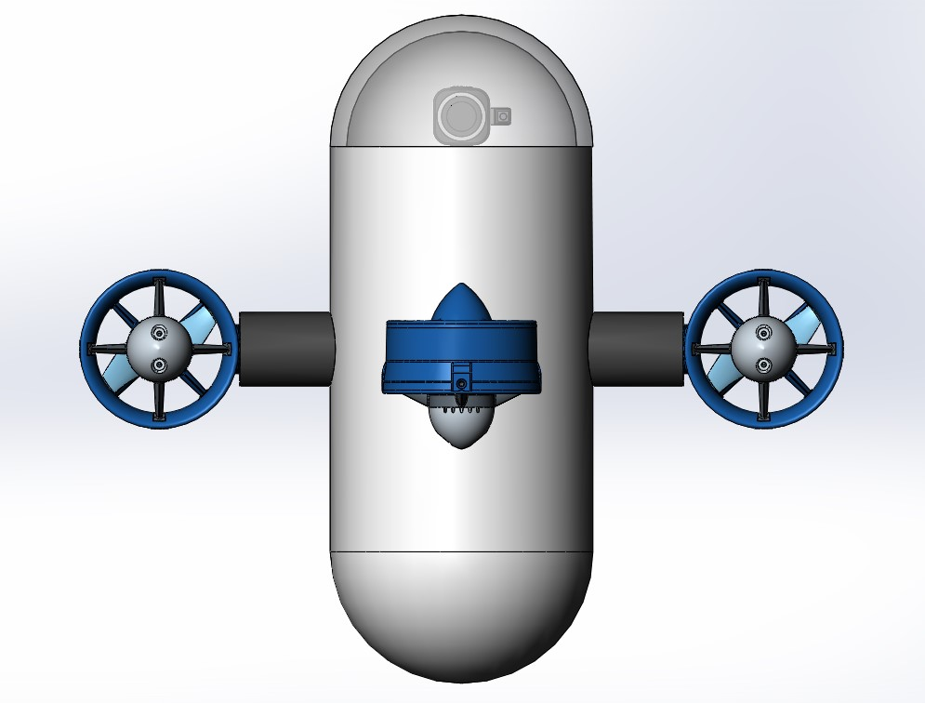
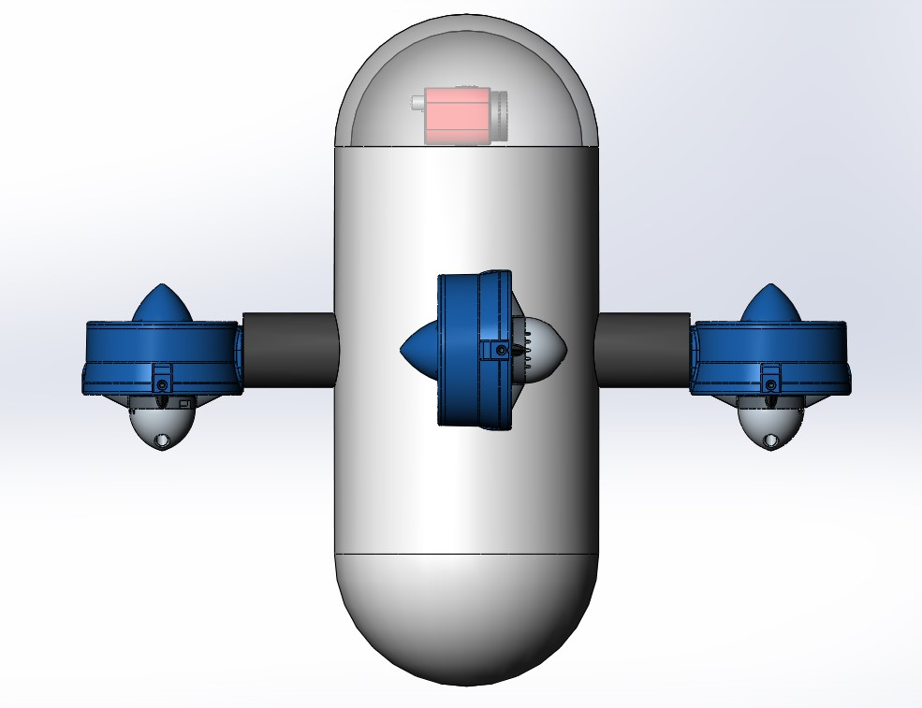
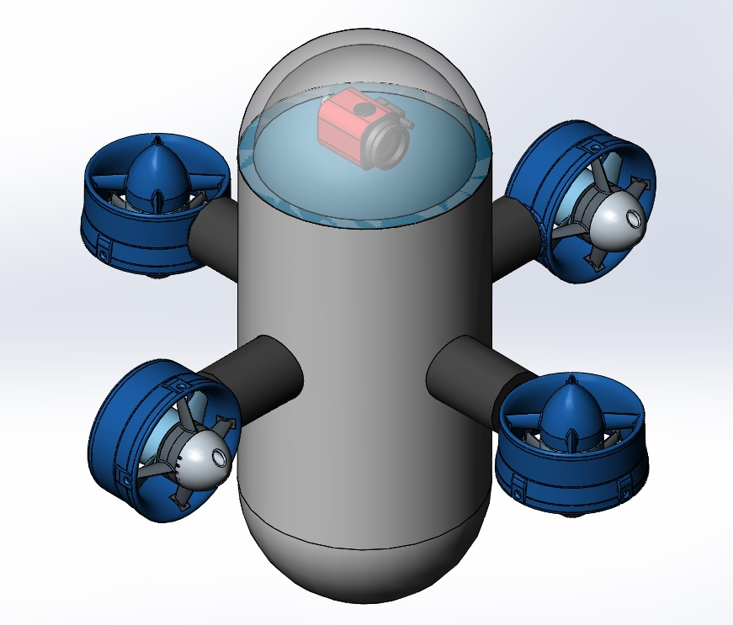
Current Model CAD :
(Addition – Glass Dome and Camera)
Front View
Side View
Isometric View

Slide 3
Current Condition of the ROV :
No electronics or sensors present, except a few ESCs
Upper part of the hull (rim) for air-tight lid is damaged.
Extra weight is present at the bottom of the hull (suitable for vertical configuration)
Limited space for electronics.
No structure is available for mounting of camera.
Thrusters, ESCs are working (yet to be checked by us)

Slide 4
Vertical Orientation :
Adding a dome for mounting the camera on the upper lid.
CG is already below the CB.
Max drag is experienced while in horizontal motion.
Therefore ideal for small area survey.
Sensors are to be attached.
Limited space for housing components
Aim : Depth of 10 meters in still water.

Slide 5
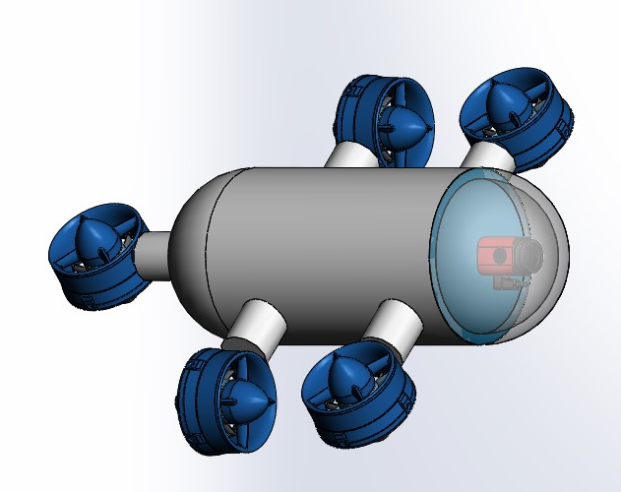
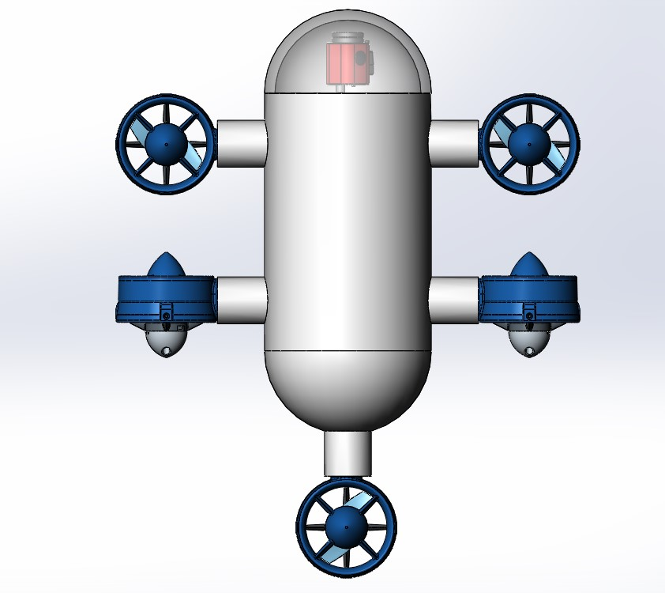
Horizontal Orientation :
Adding a dome for mounting the camera on the front lid.
CG is to be configured according to the position of thrusters and CB.
Additional thruster is required for stability.
Min drag is experienced while in horizontal motion.
Therefore ideal for underwater exploration.
Sensors are to be attached.
Limited space for housing components
Aim : Depth of 10 meters in still water.
Isometric View
Top View

Slide 6
Thank You

